Slide 1




Who we are
1933
1984
Huff-Cook Mutual Burial Assn.
Settlers Life Insurance Co.
1999
Today
A Member of the NGL Insurance Group
National Guardian Life Insurance Company is not affiliated with The Guardian Life Insurance Company of America, a/k/a The Guardian or Guardian Life.
Notes:
Settlers Life is an established final expense life insurance company, whose predecessor company began in 1933 as the Huff-Cook Mutual Burial Association. At that time, insurance certificates were sold through captive agents, predominately in Virginia.
In 1984, in an effort to broaden the lines of business which could be offered to Huff-Cook members, and also to non-members, and to create the opportunity for the company to offer life insurance plans in states other than Virginia, Huff-Cook MBA decided to create an independent life insurance company. Settlers Life was born.
Through the late 1980's and into the early 1990's Settlers Life continued to grow and to expand. And in 1999, Settlers Life became a member of the National Guardian Life Insurance Group.
Today, Settlers Life is represented by more than 5,000 agents in forty two states. Figures drawn from the September 2015 Quarterly Financial Statement of Settlers Life Insurance Company, revealed our assets exceed $383 million dollars, with more than $38 million in surplus and over $1.7 billion dollars of life insurance in force.

Slide 2
What we offer
Final Expense Life Insurance Plans
Benefits & Riders
Gold
Silver
Silver II
Bronze
Bronze II
Child/Grandchild Benefit
Accidental Death Benefit Rider
Accelerated Benefit Rider
Premium Payment Options
Lifetime Single Pay
10 Pay 20 Pay
Notes:
What do we offer?
Settlers Life Insurance Company specializes in simplified issue whole life insurance providing coverage for final expenses. We offer a variety of final expense plans and riders to meet the needs of a diverse client base. Keep in mind that not all products are available in every state. You may reference your state specific supply section on my.settlerslife.com for more information on what is offered in each state.
Settlers Life offers four premium payment options: Lifetime Pay, Single Pay, 10 Pay, and 20 Pay. Although lifetime payment is most commonly used, it may not always be the best option for you and your client.
If your client can afford the larger, one time, premium payment the Single Pay option gives them immediate peace of mind, and with no further premium payments to make, there is little or no chance of policy lapse for you. The Single Pay is not available for the Bronze or Bronze II Plans.
The 10 and 20 year payment plans have slightly higher premiums than lifetime pay, however, they come with the assurance that a policy will be paid up in a matter of years. For a younger client, the difference in monthly premiums between a 10 or 20 year pay versus a lifetime pay is very small.
Now, let’s take an in depth look at the individual products we offer.

Slide 3

Child/Grandchild
Death Benefit
One-time benefit for death of child or grandchild
Included with all Gold, Silver, and Silver II policies*
Benefit is equal to the lesser of $5,000 or the benefit amount of the base policy
NO ADDITIONAL COST
*Not available in North Dakota.
Notes:
The Settlers Life Child/Grandchild Benefit is a one-time benefit paid due to the death of one child or grandchild of the Insured. This benefit is added to all Gold, Silver, and Silver II policies, except in North Dakota where it is unavailable. The benefit is included for no additional cost. The Child/Grandchild benefit is equal to the lesser of $5,000 or the benefit amount of the base policy. The Child or Grandchild must be between the ages of 6 months and 18 years, born or legally adopted by the Insured or born or legally adopted by a child of the Insured, must be living with a parent or grandparent at the time of death, must never have been married, and shall not have committed suicide or self destruction within two years of the effective date of the policy. Best of all, there is no additional cost and no additional paperwork required at the time of application!

Slide 4

Accidental Death
Benefit Rider
Additional coverage if death results from an accident – as defined in the rider
Available ages: 15 days – 70 years
Terminates at age 80
Details and forms may vary by state and plan.
Notes:
The Settlers Life Accidental Death Benefit Rider can be added to any plan offered by Settlers Life. This rider provides for additional coverage if death results from an accident as defined in the Rider. It is available for issue from ages 15 days to 70. This Rider terminates on the policy anniversary date on which the insured is age 80.

Slide 5
Accelerated Benefit Rider
Added to Gold, Silver, and Silver II policies with $5,000 or more in coverage
NO ADDITIONAL COST
Accelerated living benefit if diagnosed with terminal condition or continuous confinement in a nursing home*
Designed to provide insureds and their families with benefits before death
*The insured must be diagnosed after the effective date of the policy’s coverage as having a terminal illness with a life expectancy of six months or less; The insured may also apply for an accelerated living benefit if he or she is diagnosed as requiring continuous care in a nursing home. Details and forms may vary by state.
Notes:
For those clients who purchase a Gold, Silver, or Silver II policy with $5,000 or more of coverage, Settlers Life will add this Rider to the Policy at no additional cost. The Settlers Life Accelerated Benefit Rider allows the policyowner to apply for an accelerated living benefit of up to 75% of the current policy death benefit if the insured is diagnosed after the effective date of the policy's coverage as having a terminal illness with a life expectancy of six months or less.
Your client may also apply for an accelerated living benefit if he or she is diagnosed as requiring continuous care in an eligible nursing home and the confinement is expected to continue until the Insured’s death.
This Rider was designed to provide insureds and their families and loved ones with benefits before death to help in those difficult times.

Slide 6
Trusts
NGL Funeral Expense Trust*
Generally funds excluded from assets for Medicaid/SSI qualification
Maximum face amount $15,000 (Varies by state)
Excess funds paid to State Medicaid Recovery Program or Estate of the Owner
No Fees
NGL Estate Planning Trust**
Funds not excluded from assets for Medicaid or SSI spend down until 5 years after assignment
Maximum face amount $50,000
Excess funds paid to named beneficiary
No Fees
Plan limits and maximum total coverage limits still apply.
*Not available in Florida, Massachusetts, Michigan, or Texas
**Not available in Massachusetts
For Partner Training Only
Notes:
Settlers Life also offers the NGL Funeral Expense and Estate Planning Trusts in many states. These trusts are highly transportable and may help protect your clients’ assets.
With the NGL Funeral Expense Trust, generally funds are excluded from assets for Medicaid or SSI qualification. The maximum face amount for the FET is $15,000, but may vary by state. Excess funds are paid to the State Medicaid Recovery Program or to the Estate of the Owner. There are no fees for assigning a policy to the FET. The FET is not available in Florida, Massachusetts, Michigan, or Texas.
The NGL Estate Planning Trust offers a maximum face amount of $50,000. Excess funds are paid to a named beneficiary such as a relative or favorite charity. With the EPT, funds are NOT excluded from assets for Medicaid or SSI spend down until 5 years after assignment. There are no fees for assigning a policy to the EPT. The EPT is not available in Massachusetts.
Trust assignment must be made at the time of application and requires completion of a Funeral Expense or Estate Planning Trust form.

Slide 7

Covered!
Notes:
And last, but not least - Covered!, by Settlers Life. With Covered!, Settlers Life can now provide final expense life insurance, consumer education and protection, and end of life planning all wrapped into one. Or simply put, Settlers Life provides assistance and solutions before, during, and after death.

Slide 8



Client Brochures
Notes:
As part of our new product rollout, Settlers Life has released a new brochure as a sales tool for our partners. Within the brochure, you will find helpful facts and product information to present to your clients about final expenses and how a policy with Settlers Life can get them Covered!

Slide 9

Covered!
Planning Guide
Summary page for policy benefit and premium amounts
Consumer rights under the FTC Funeral Rule
Planning pages for client
End-of-life-resources
Insert your business card!
Notes:
In addition, Settlers Life has implemented a new Covered! Planning Guide to be left with your client. In the guide, you can fill in your client’s policy benefit and premium amounts. Other information inside includes: consumer rights under the FTC Funeral Rule, end-of-life planning pages for the client to complete, end-of-life resources, and, inside the back cover, a place to put your business card!

Slide 10
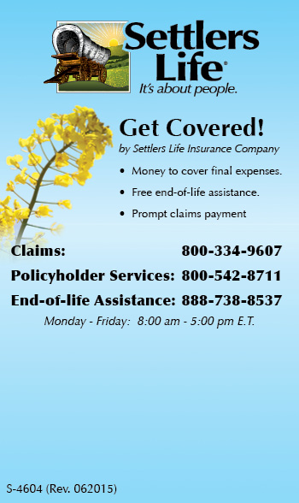

Magnets
Notes:
Covered! Magnets
The magnet highlights the Covered! program and has a space at the bottom where you should insert your Settlers Life business card. provides you with a great leave behind and prospecting tool when dealing with your prospects and clients. Here’s how you can best utilize the magnet as a leave behind. Your new client gets Covered!!. You simply ask if it is okay with him to give a magnet to his neighbor to the left right, behind and in front of him. This creates a + (Plus) sign and becomes a Plus prospecting tool. Most people know and respect their neighbors. So, if your client says it is okay to bring his neighbor a magnet to put on his refrigerator, then proceed next door to deliver and place on the magnet on the neighbor’s refrigerator. The neighbors will likely want to know to know more details about the Covered!! Program. Due to privacy laws, you cannot share any personal information to include health, policy, or financials about your client with his neighbors. Why chase leads when all you have to do is share with neighbors that they can be Covered!!
In closing, when you say you are Covered!! with Settlers, you have the finest final expense program good enough for your own Mom and Dad…good enough for you. You have insurance protection, end of life assistance, and fast claims payment. And now you have the tools to inform, educate, and take your final expense career to new heights. You’re Covered!! by Settlers Life Insurance Company!

Slide 11

Reward Programs
Awards new partners during the first 12 months after writing their first application.
Rewards are given at different levels of production.
Become A ‘Wagon Master’ and win a weekend get-away for 2!
Notes:
The Expedition to Excellence is our incentive program for new partners. E 2 E rewards you during the first 12 months after writing your first application with Settlers Life. As you reach each new specified level of production, we will reward you with everything from a notepad to a weekend get-away for you and your spouse!

Slide 12


Reward Programs
Write at least $12,500 in net-annualized premium within 90 days of your first app being approved and “Pick A Place” to spend a 3-day/2-night stay
For Agent Training Only
Notes:
Pick A Place awards partners who write at least $12,500 in net-annualized premium within 90 days of writing their first Settlers Life application. When a partner meets the production and quality guidelines, we’ll send them and a guest to a destination of their choice for a 3-day/2-night stay which includes airfare, hotel, and $300 cash!

Slide 13

Reward Programs
For Agent Training Only
Notes:
Our 2017 sales conference only requires $50,000 in net-annualized premium to qualify at the Achiever Level or $250,000 for the Agency Achiever level.
In 2017, we’ll be losing ourselves on a 6-day cruise aboard Royal Caribbean’s newest ship, Anthem of the Seas, to Bermuda! Partners who qualify with at least $100,000 in net-annualized premium ($500,000 for partner agencies) will join us for an extra two days in New York City before the cruise departs!

Slide 14
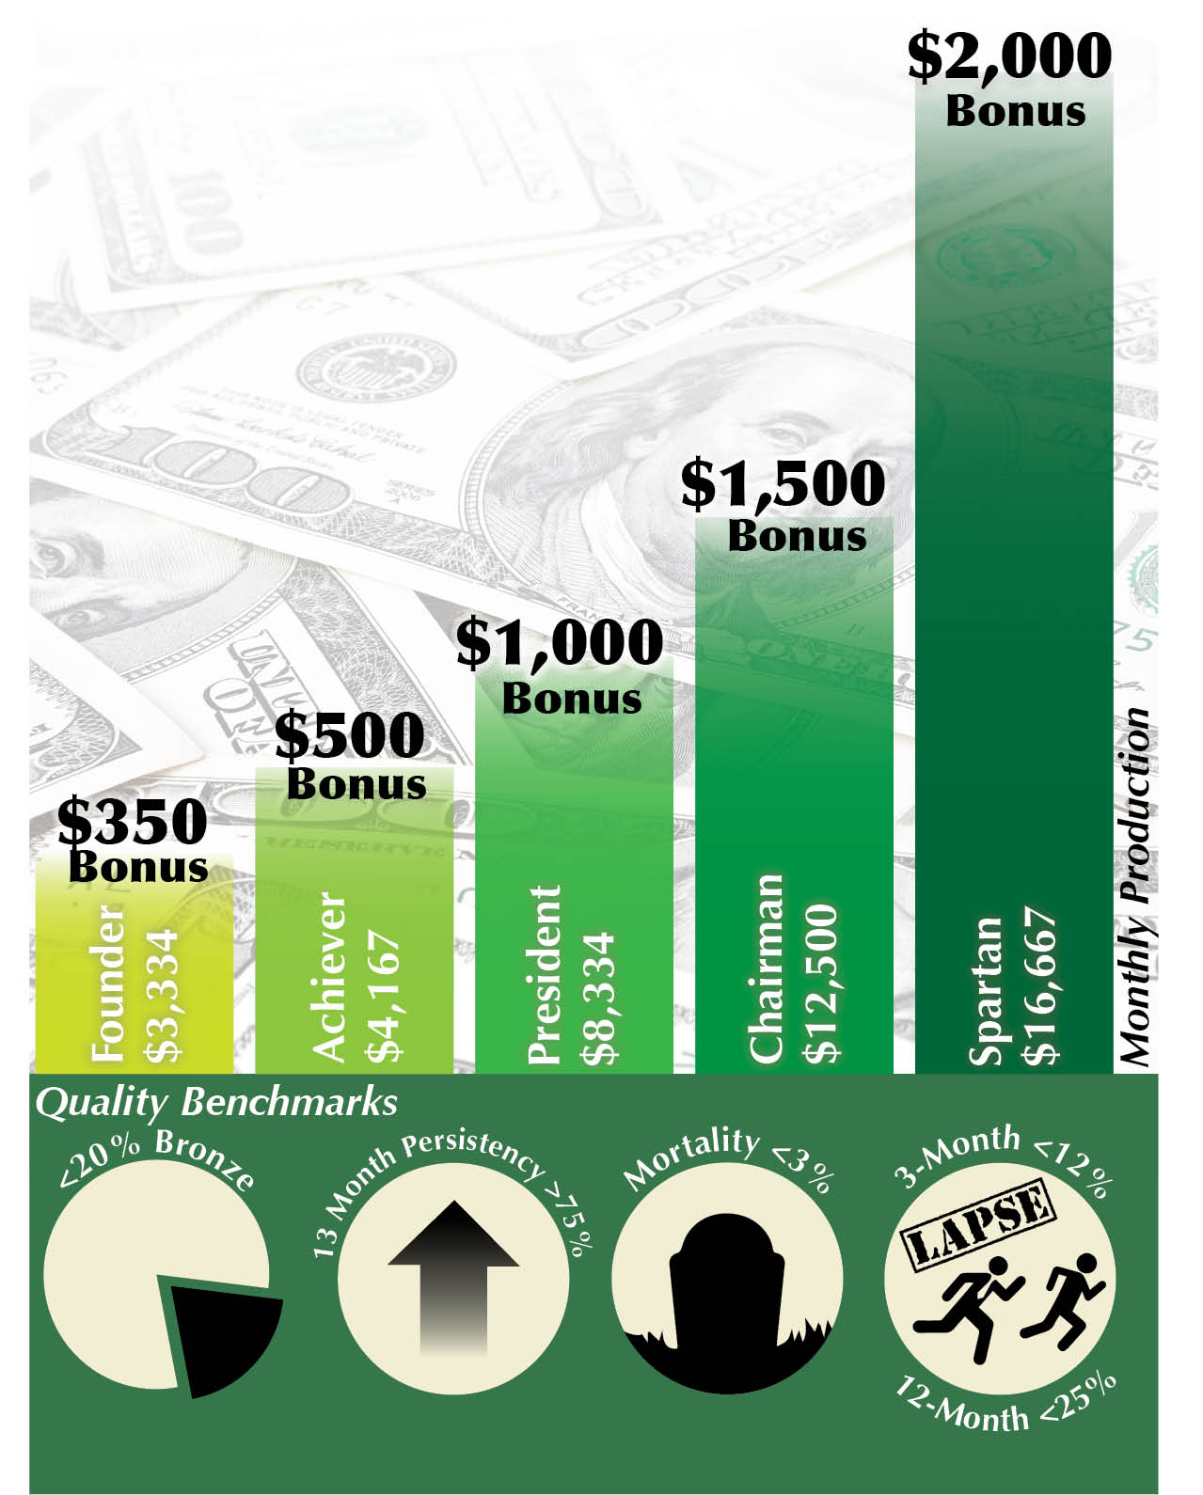
Reward Programs
25% of single pay net-annualized premium will count towards average monthly production for the Benchmark Bonus and Sales Conference production.
Notes:
Bonuses are paid to qualifying individual partners monthly and are dependent upon adherence to our quality benchmark requirements. Write at least $3,334/month in net-annualized premium while meeting quality benchmarks and you’ll get a bonus! If you write $4,167/month or more, you’ll also be on-pace to join us in 2017 on the cruise to Bermuda!
25% of single pay net-annualized premium will count towards average monthly production for the Benchmark Bonus and Sales Conference production.

